Slide 1
Electromagnetic transition strengths as indicators of collectivity Alexandra Gade
Monday
Tuesday
Thursday
Introduction – electromagnetic transition strengths
Excitation strength from Coulomb excitation – at the Coulomb barrier and with fast beams
Excited-state lifetime measurements: DSAM, RDDS, fast timing
Experimental considerations

Slide 2
Outline
Introduction: How can we characterize and quantify collective properties of exotic nuclei? Two general approaches – transition strength from inelastic scattering and lifetime measurements
Modern experiments: Recent examples – Physics background and experimental approach
Low-energy Coulomb excitation – Sr isotopes
Intermediate-energy Coulex – Sn isotopes
DSAM – ¹⁰⁶Cd excited-state lifetimes from γ line shapes
RDDS – plunger measurements of ⁴⁴S

Slide 3
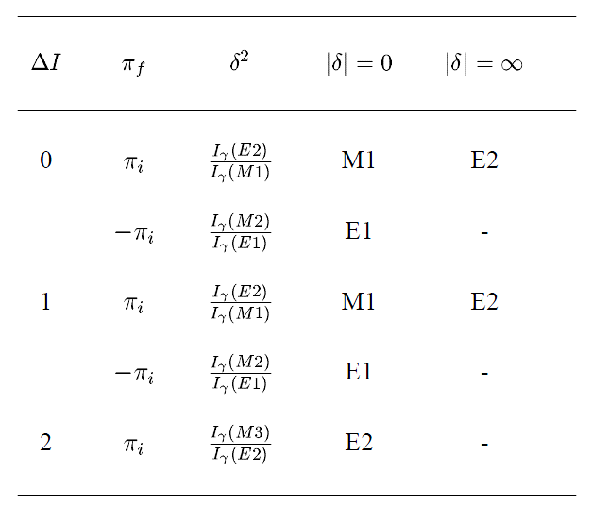
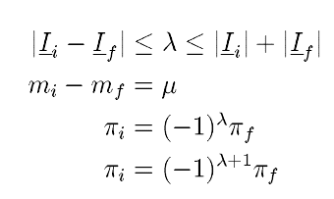
Electromagnetic transition strength
Question
How likely is a state to decay or can be excited and what does it tell us?
Two bound states
I_{i}
Two bound states
I_{f}
γ-ray transition
Real or virtual photon, hadronic interaction
I_{f}
I_{i}
Electric multipole radiation
Magnetic multipole radiation
λ multipolarity

Slide 4
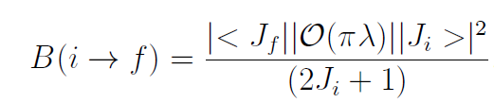
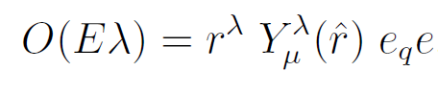
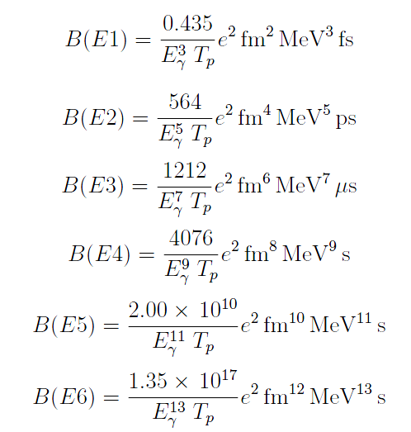
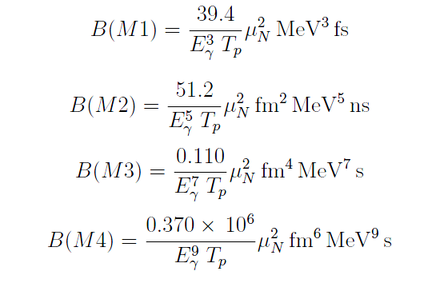
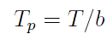
Electromagnetic transition strength and relation to lifetimes
Reduced transition strength
Partial half-life that includes branching ratios, Eλ/Mλ’ fractions, conversion coefficients, …

Slide 5
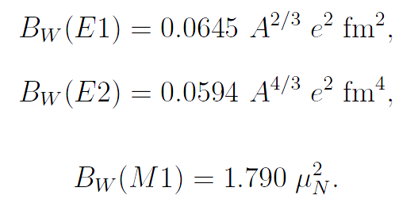
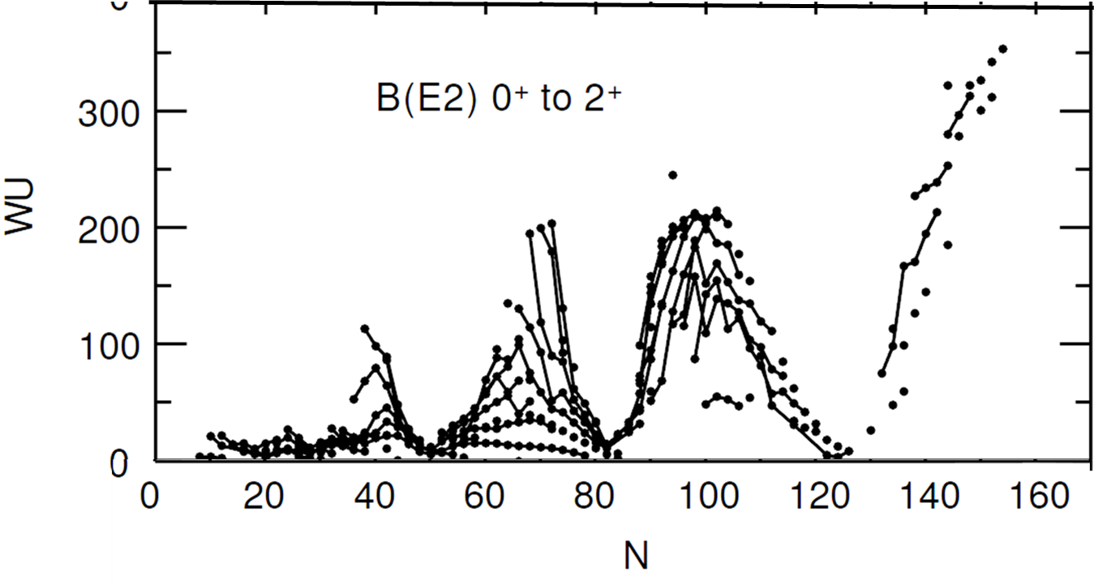
What are transition strength good for? Example: Even-even nuclei
WU: Weisskopf unit – estimate of what the transition strength in a nucleus with mass A would be if the transition was mediated by a single particle
N=82
N=50
N=126
N=20
N=28
In between shell closures, the nuclei exhibit collectivity (vibrational or deformed)

Slide 6
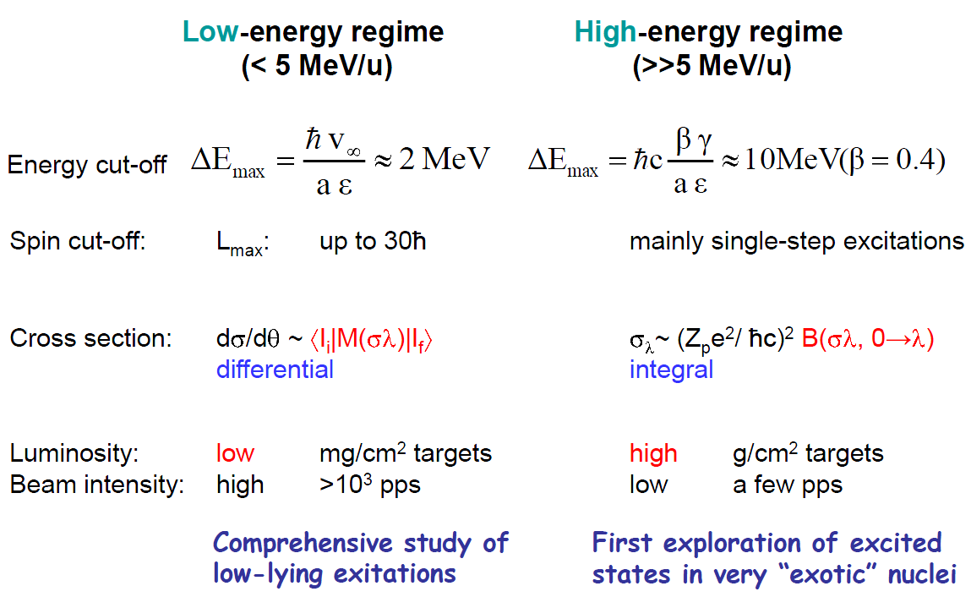
Transition strength and moments from Coulex
Figure from M. Huyse
Adapted from W. Korten (Saclay)

Slide 7
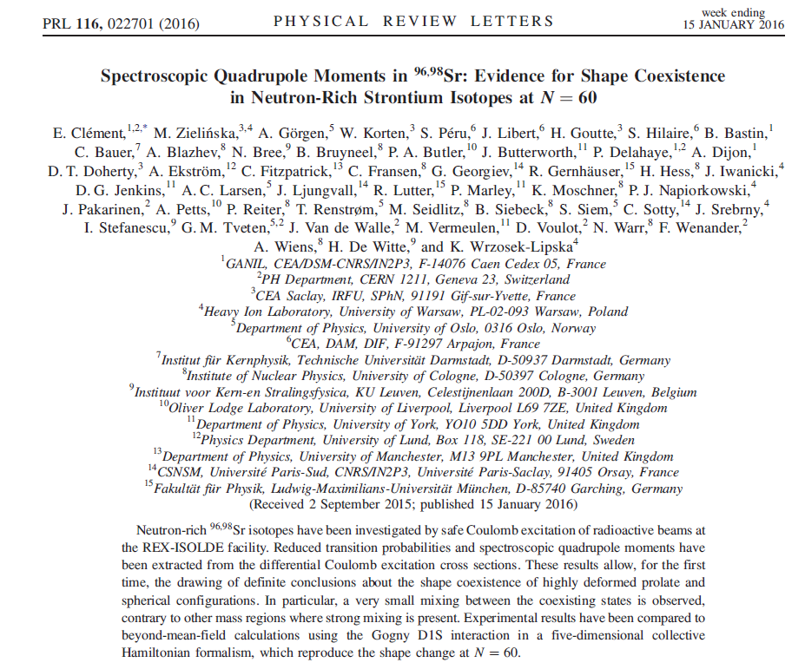
How can we probe this in an experiment …
Figure from M. Huyse

Slide 8
Shape coexistence in neutron-rich Sr isotopes at N=60
A sudden onset of collectivity has been observed for neutron-rich Zr and Sr nuclei at N=60
Furthermore, low-lying excited 0⁺ states have been observed that may differ in shape from the ground state
Strategy: Perform low-energy Coulomb excitation and measure transition strength (measure of collectivity) and moments (shape)
^{96,98}Sr radioactive beam at ~275 MeV was provided at ISOLDE CERN (intensities: high 10³ and mid 10⁴pps). The Coulomb excitation was tagged through the γ-ray decays of the populated states. B(E2) strengths and moments were deduced from coupled-channels fits (GOSIA)
Figure from M. Huyse

Slide 9
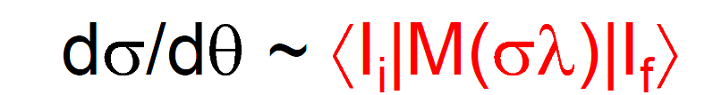
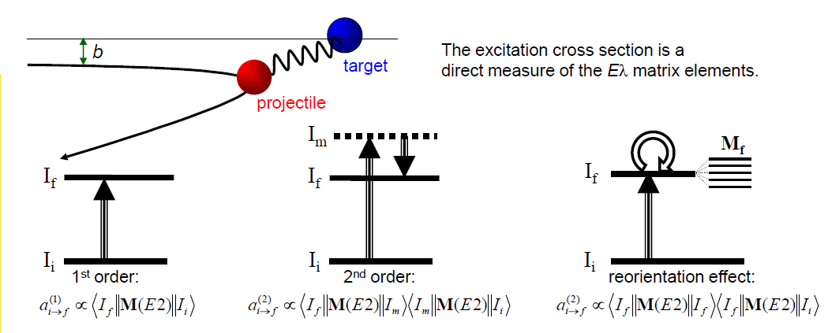
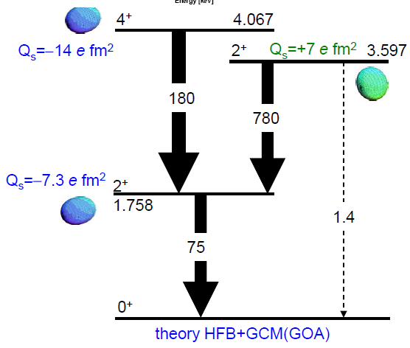
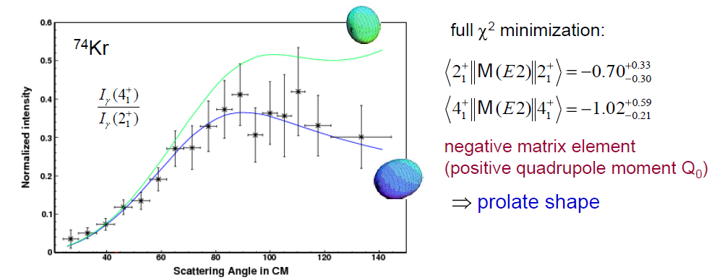
Transition strength and moments from Coulomb excitation
Figure from M. Huyse
Adapted from W. Korten (Saclay)

Slide 10
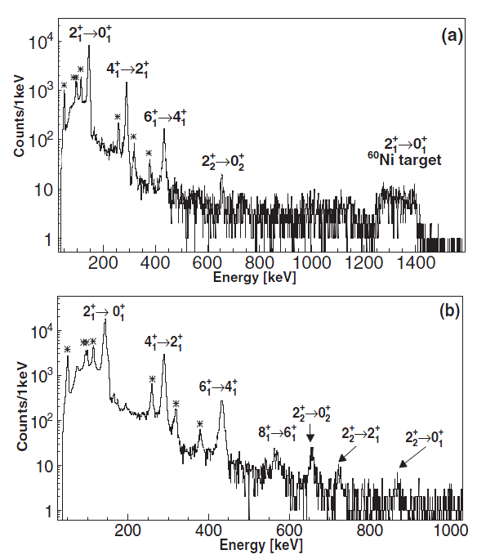
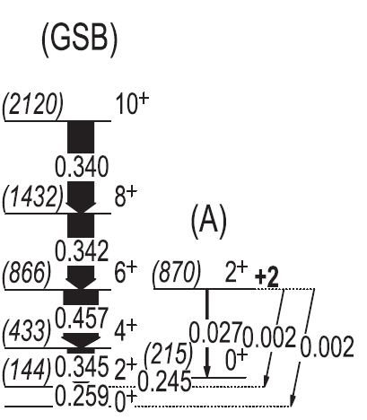
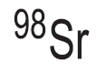
Shape coexistence in neutron-rich Sr isotopes at N=60
⁹⁸Sr+⁶⁰Ni
⁹⁸Sr+²⁰⁸Pb
Figure from M.
E. Clement et al., PRL 116, 022701 (2016) and PRC 94, 054326 (2016)

Slide 11
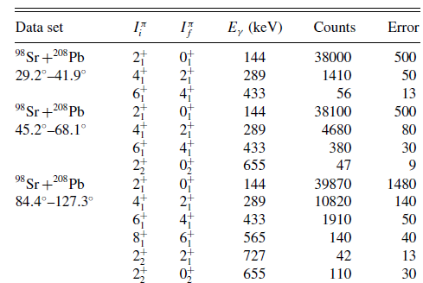
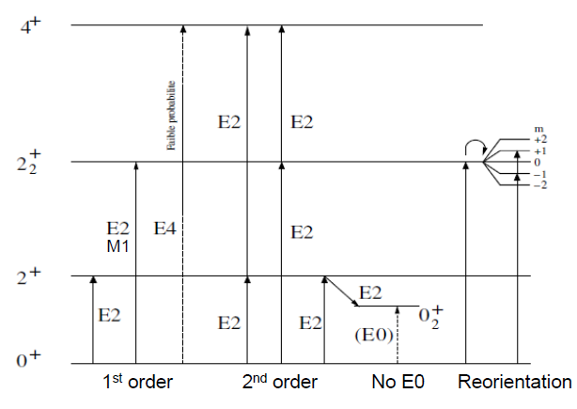
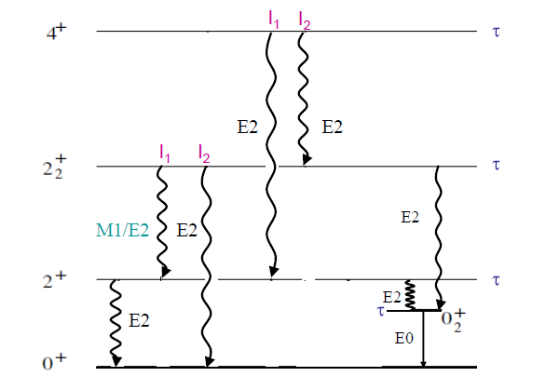
Shape coexistence in neutron-rich Sr isotopes at N=60
Determine differential cross sections
E. Clement et al., PRC 94, 054326 (2016)
And set up the coupled-channels minimization, using all possible data to constrain the excitation and decay scheme … out come (self-consistent) transition matrix elements and moments
…
Adapted from W. Korten (Saclay)

Slide 12
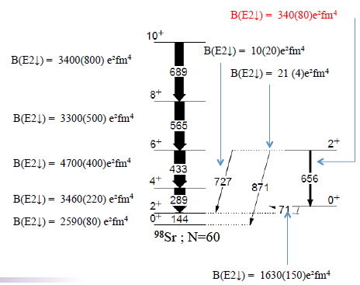
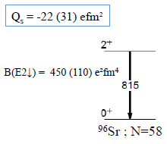
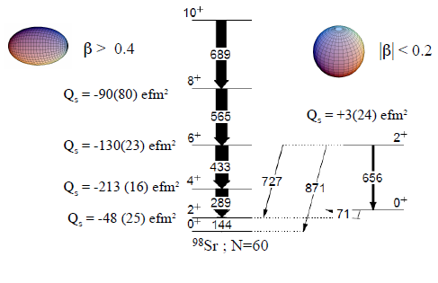
For ⁹⁶Sr and ⁹⁸Sr: ⁹⁸Sr is a lot more collective than ⁹⁶Sr, is deformed, and has shape coexistence
Outcome: Suspected shape coexistence confirmed at N=60 and transition strength quantifies onset of collectivity between A=96 and 98 in Sr
Figure from M. Huyse
Adapted from E. Clement

Slide 13
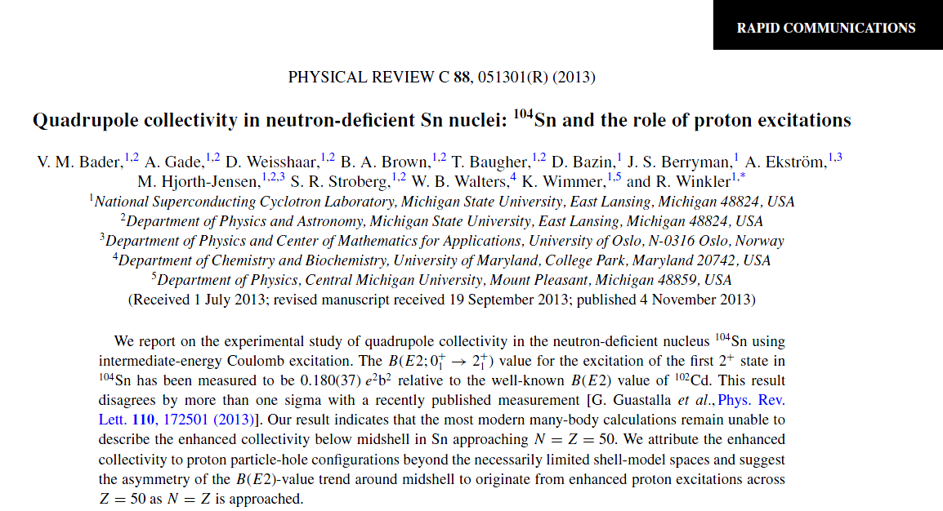
Single-step Coulomb excitation of neutron-deficient Sn isotopes
Figure from M. Huyse

Slide 14
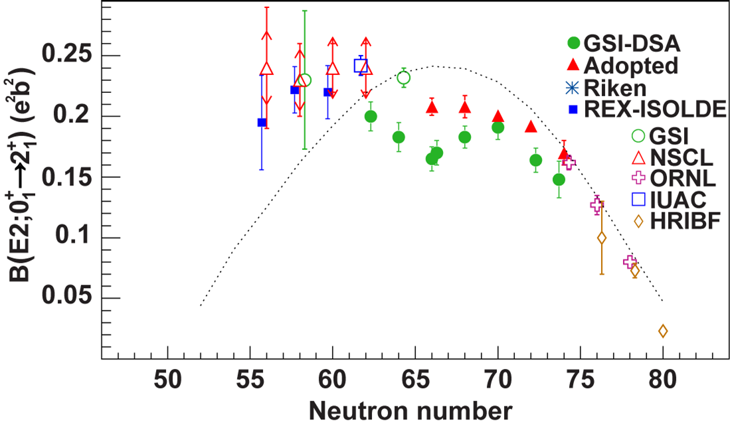
Collectivity of neutron-deficient Sn isotopes
There has been a long-standing puzzle as to how the B(E2) strength develops toward ¹⁰⁰Sn (even at stability, the data don’t agree but that is another story …)
Up to 2014, ¹⁰⁶Sn was to most neutron-deficient Sn isotope available for in-beam experiments – how is the evolution of B(E2) for ¹⁰⁴Sn?
Strategy: Perform a fast-beam Coulomb excitation experiment (low-energy would not have worked due to the lack of intensity!)
¹⁰⁴Sn produced from fragmentation of a 140-MeV/u ¹²⁴Xe stable beam. The Coulomb excitation of the 2⁺₁ state was tagged and quantified by γ-ray spectroscopy with CAESAR
Figure from M. Huyse
V. Bader et al., PRC 88, 051301(R) (2013)

Slide 15
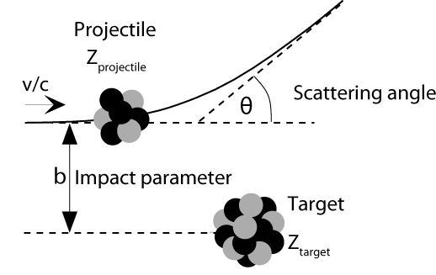

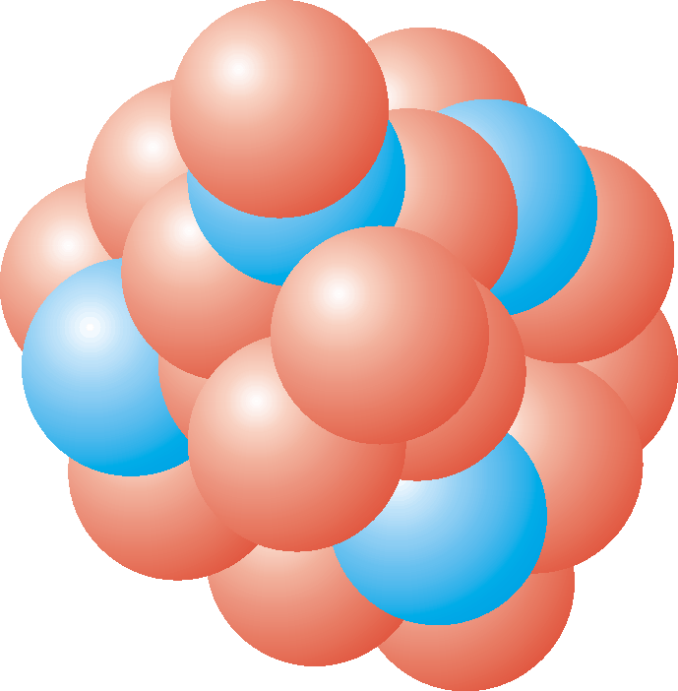
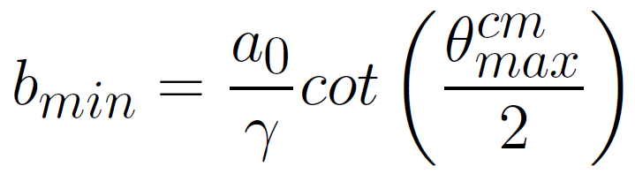
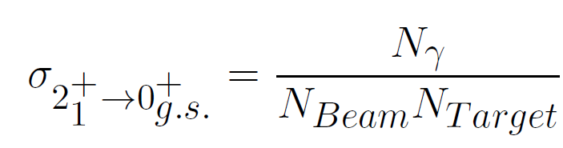
Intermediate-energy Coulomb excitation – γ-rays tag the inelastic process
The projectile is excited in the strong Coulomb field of the target (typically high-Z)
Scattering angle is used to constrain impact parameter to safe distances
Angle-integrated cross sections are translated into B(E2:0⁺_{g.s.}→2⁺₁) excitation strength
At NSCL: following the prescription of Winther and Alder
b > b_{min} = 1.25 fm (A_{P}^{1/3}+A_{T}^{1/3}) + 2 fm
Aage Winther and Kurt Alder, NPA 319, 518 (1979)
A. Gade and T. Glasmacher, Prog. in Part. and Nucl. Phys. 60, 161 (2008)

Slide 16
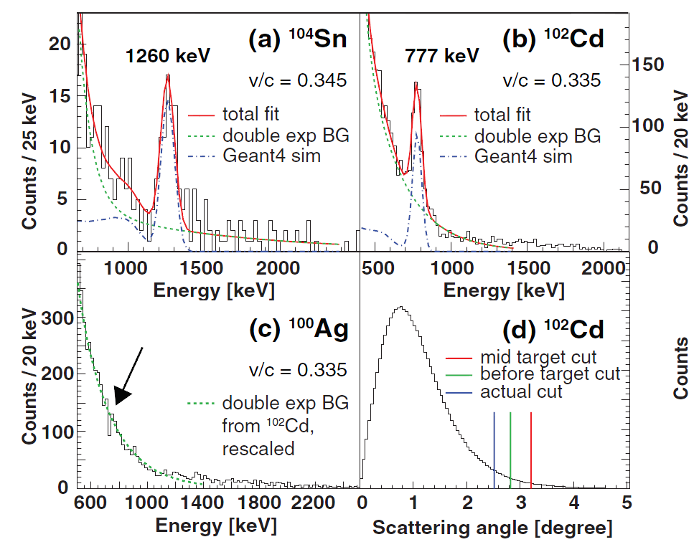
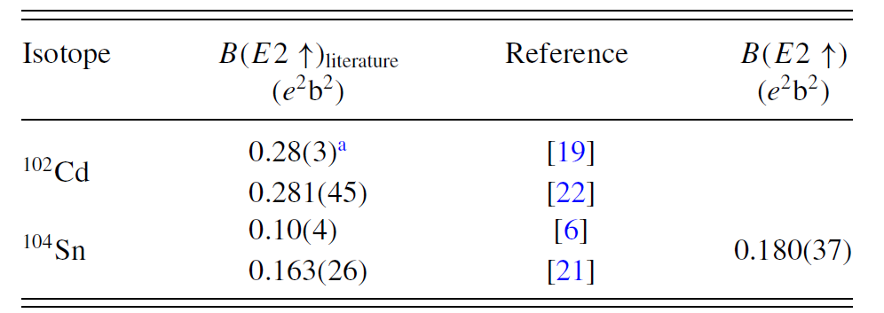
Collectivity of neutron-deficient Sn isotopes
# projectiles? Count …
# γ-rays? Peak area divided by detection efficiency
# nuclei in target? You better know the thickness …
CAESAR: Array of 192 CsI(Na) scintillation detectors, essentially covering 4π
V. Bader et al., PRC 88, 051301(R) (2013)

Slide 17
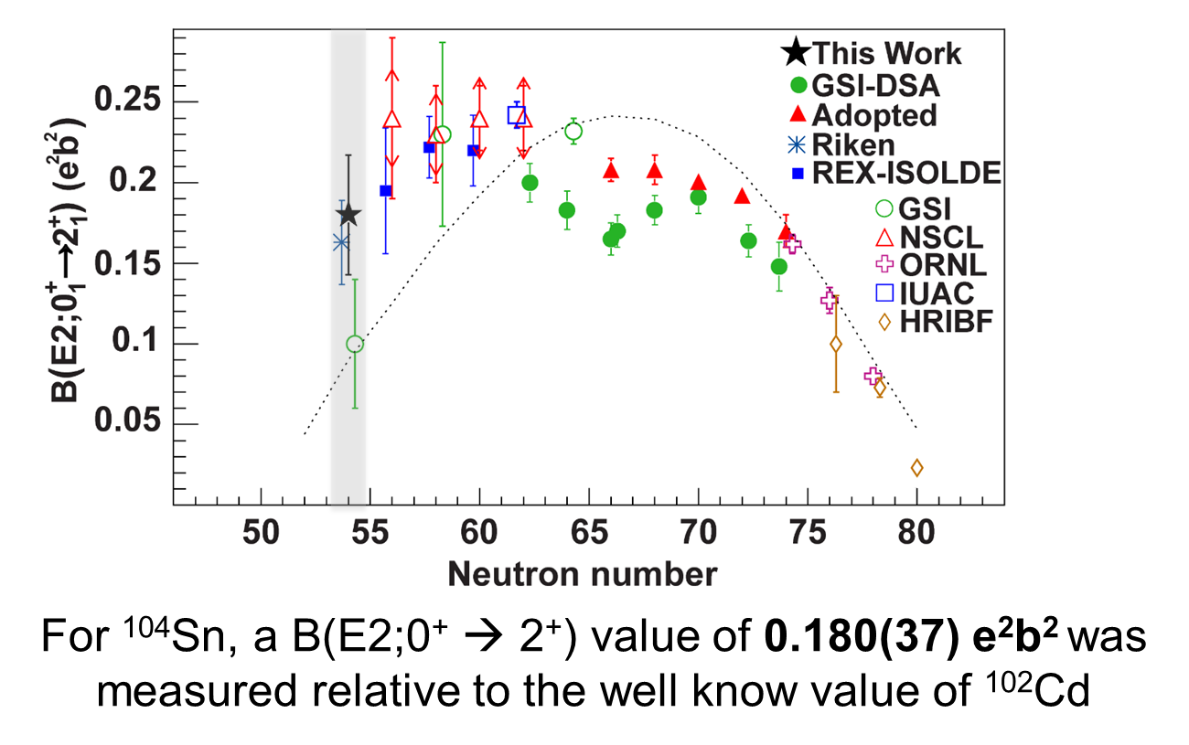
Status of the knowledge of quadrupole collectivity for Sn nuclei to date
V. Bader et al., PRC 88, 051301(R) (2013)

Slide 18
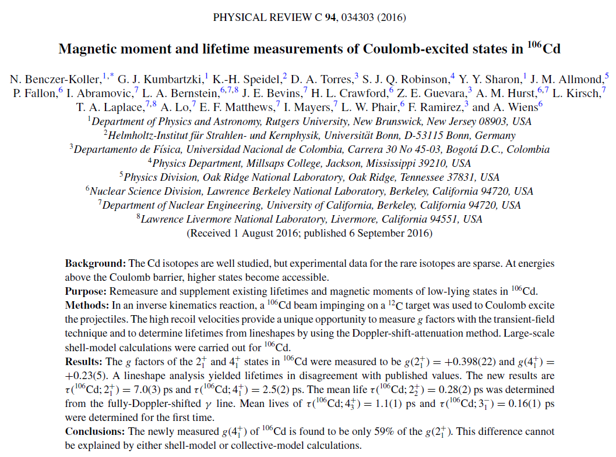
Transition strength in ¹⁰⁶Cd – not radioactive, but rare (1.25% abundance)
Figure from M. Huyse

Slide 19
¹⁰⁶Cd
Cd with Z=48 is two proton holes removed from the Sn isotopic chain
Do we understand the collectivity of neutron-deficient Cd?
Strategy: Measure the excited-state lifetimes of ¹⁰⁶Cd using the velocity- and angle-dependent Doppler shift of γ-rays emitted in flight
¹⁰⁶Cd stable beam was provided by 88-inch cyclotron at LBNL. Excited-states were populated in inelastic scattering on ¹²C.
Figure from M. Huyse

Slide 20
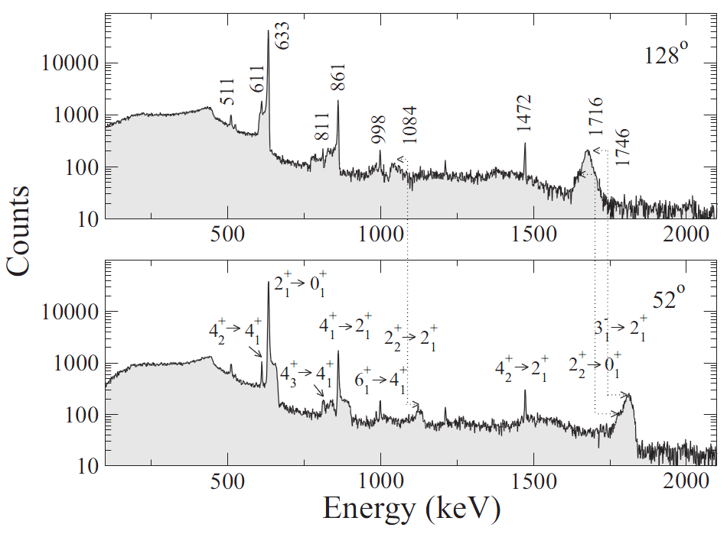
Transfer reactions with HELIOS – single-particle neutron energies outside of ¹³⁶Xe
γ-ray detection
Backward angle
Forward angle
N. Koller et al., PRC 94, 034303 (2016)

Slide 21
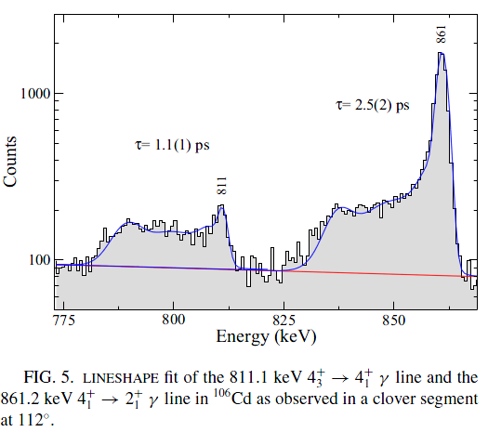
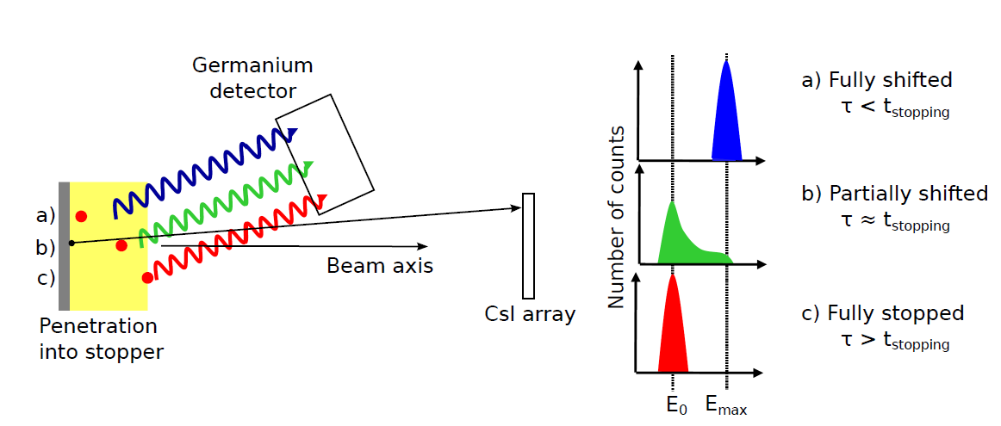
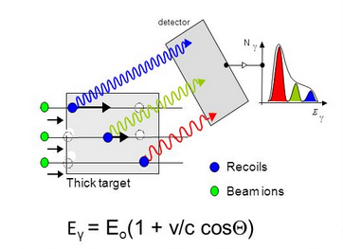
¹⁰⁶Cd
Detection under backward angles
Detection under forward angles
Figure from M. Huyse

Slide 22
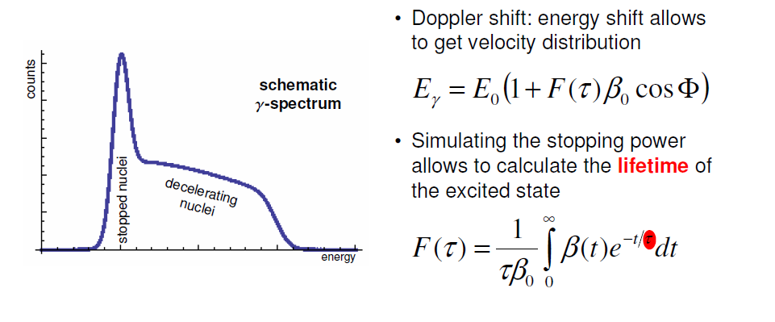
¹⁰⁶Cd
Adopted from C. Herlitzius
Figure from M. Huyse

Slide 23
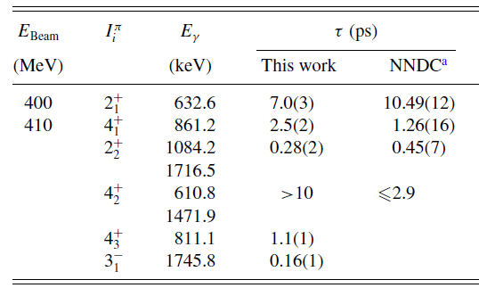
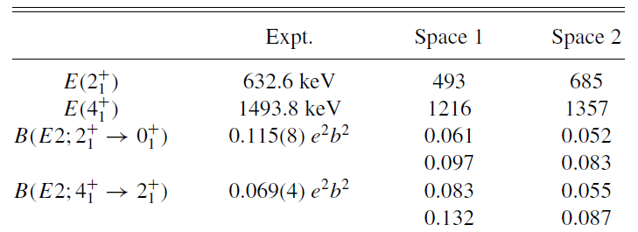
¹⁰⁶Cd
Interesting: excited-state lifetimes disagree with literature values when available
Is shell model able to describe the Cd isotopes? Two model spaces with two sets of effective charges do not seem to get the ratios of the B(E2) values right that involve the 2⁺₁ and 4⁺₁ states
Shell model
Figure from M. Huyse
N. Koller et al., PRC 94, 034303 (2016)

Slide 24
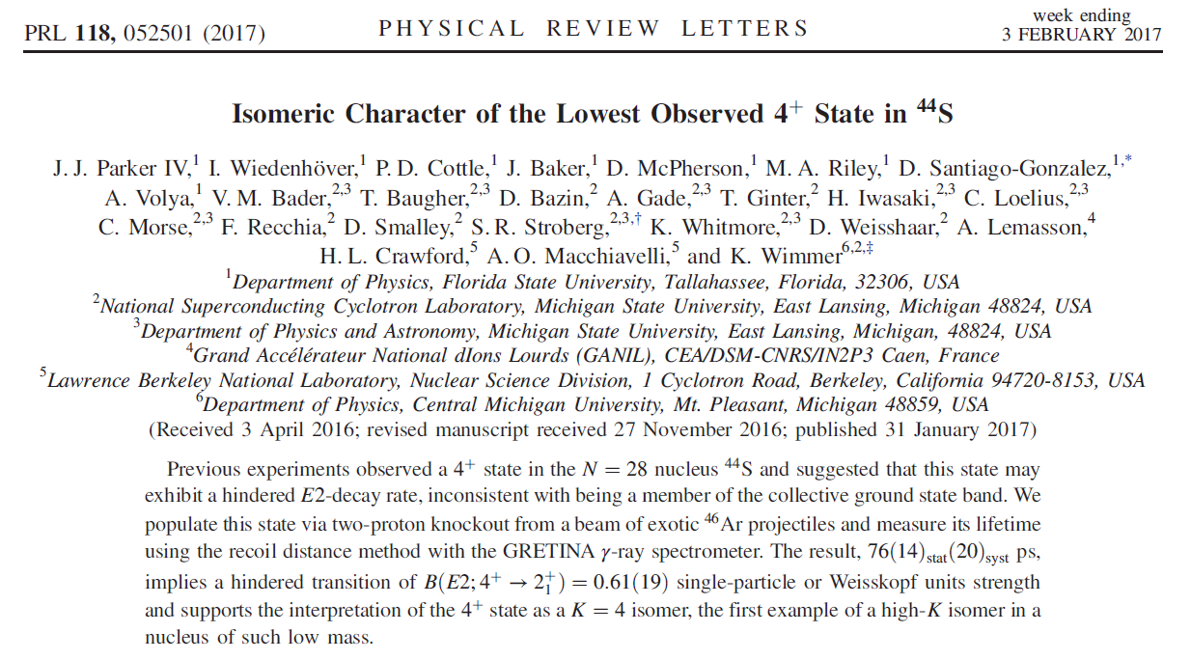
Configuration coexistence in ⁴⁴S

Slide 25
Reduced collectivity in ⁴⁴S
An earlier experiment hinted at a long lifetime for the first observed 4⁺ state in ⁴⁴S
This is unusual since typically in collective even-even nuclei, the 4⁺₁ → 2⁺₁ transition strength is high, mediated by a short level lifetime for the 4⁺ state
Strategy: Measure the excited-state lifetime of the first known 4⁺ state in ⁴⁴S
Using a plunger target system, excited states in ⁴⁴S were populated in the two-proton removal from ⁴⁶Ar projectiles that were produced inflight by fragmentation of a stable ⁴⁸Ca beam
Gamma rays were detected with the high-purity Ge detector array SeGA
Figure from M. Huyse

Slide 26
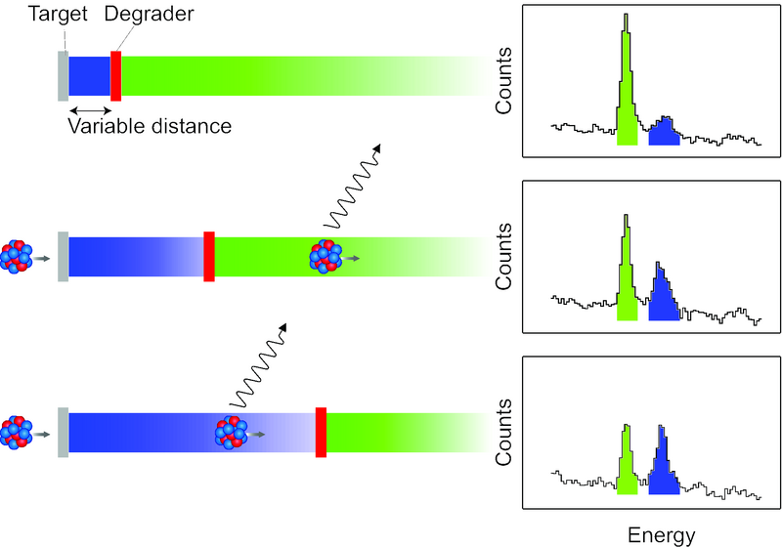
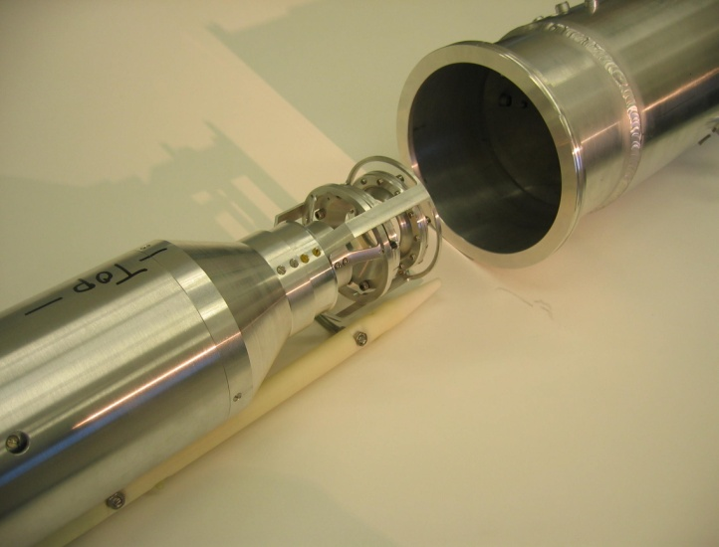
Precision excited-state lifetimes: The Recoil Distance Doppler-Shift (RDDS) method
The method
NSCL/Köln plunger device

Slide 27
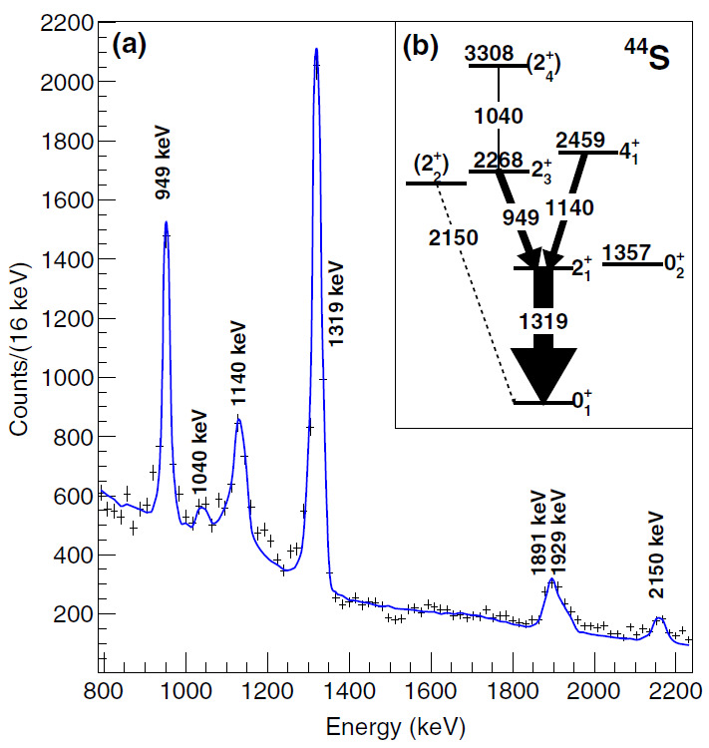
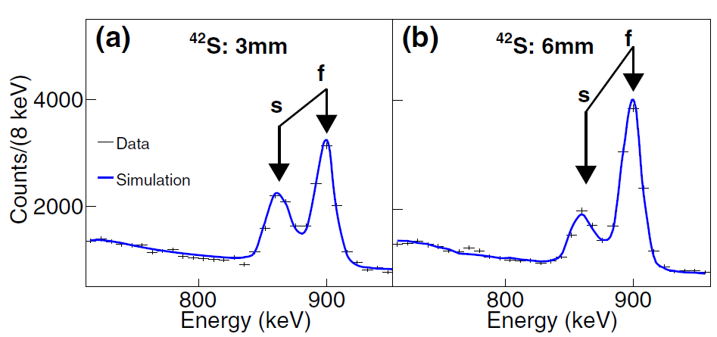
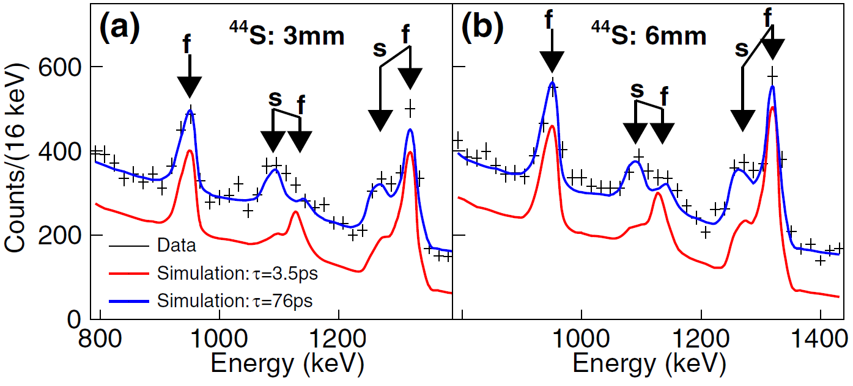
Lifetimes measured with a plunger device
Test case
B(E2; 4⁺₁ → 2⁺₁)=0.61(19) W.u.
τ=76(14)_{stat}(20)_{sys} ps
J.J. Parker et al., PRL 118, 052501 (2017)

Slide 28
⁴⁴S – an unusual 4⁺ isomer
⁴⁴S: B(E2; 4⁺₁ → 2⁺₁)=0.61(19) W.u. is very small as compared to
“typical” B(E2; 4⁺_{rot} → 2⁺₁)=9-14 W.u.
The small B(E2) indicates that the observed 4⁺ state is not a member of the ground-state rotational band and rather has a very different, pure configuration that hinders the decay to the ground-state band
In the shell model, such a 4⁺ state exists indeed and may indicate a new kind of isomerism in light nuclei
Challenge to complete the picture: Find the collective 4⁺ state that connects strongly to the 2⁺₁ state
Figure from M. Huyse
J.J. Parker et al., PRL 118, 052501 (2017)

Slide 29
Experimental considerations
Coulomb excitation
Around and below the Coulomb barrier: Multistep excitations possible, moments can deduced (tells about shape) – issues: due multi-step, feeding may become an issue; intensities of 10⁴ pps and higher are needed
At intermediate or relativistic energies: Single-step, little feeding issues, can be done at ~1 pps intensities (furthest reach) – issues: no access to moments or collective band structures, model dependent
Lifetime measurements
Model independent, often very precise, many states can be accessed depending on chosen population mechanism – issues: Target thicknesses, beam energy, and lifetime need to fit (not all methods can access all lifetime ranges), feeding is often an issue, higher intensity need than Coulex,
Fast-timing methods are (re)entering the market but are not yet competitive for rare isotopes in the sub-nanosecond regime (my view …)

Slide 30
Related review articles
A. Görgen, Shapes and collectivity of exotic nuclei via low-energy Coulomb excitation, J. Phys. G: Nucl. Phys. 37 103101 (2010)
T. Glasmacher, Coulomb excitation at intermediate energies, Annu. Rev. Nucl. Part. Sci. 48, 1 (1998)
A. Dewald et al., Developing the Recoil Distance Doppler-Shift technique towards a versatile tool for lifetime measurements of excited nuclear states, Prog. Part. Nucl. Phys. 67, 786 (2012)

Slide 31
Appendix

Slide 32
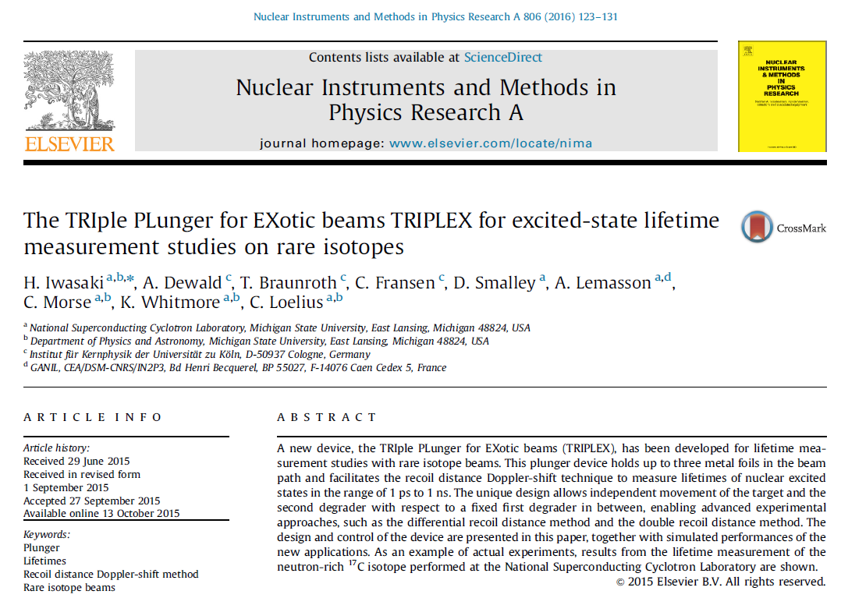
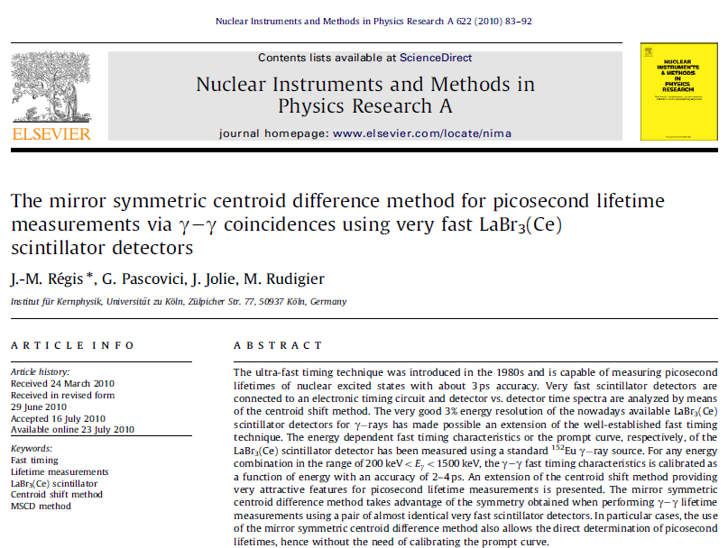
Novel approaches – a new plunger and clocking transitions directly

Slide 33
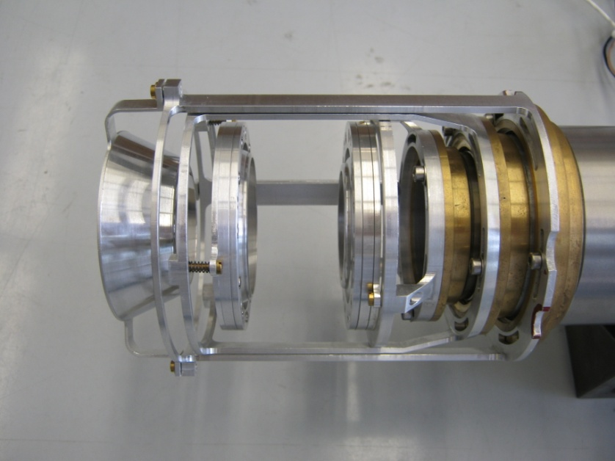
Excited-state lifetime measurements with TRIPLEX
(TRI-FOIL PLUNGER for EXOTIC BEAMS)
N(decay)
Target
Degrader
Target Degrader Degrader
reduced
(differential)
2nd Degrader
Beam
Gamma
Spectrum
slow
fast
Eγ

Slide 34

A novel twists – what if we put two degraders into a plunger device?
¹⁷C
τ=528(21)ps
for 1/2⁺
22(3)ps
for 5/2⁺
Can measure two very different lifetimes in one shot with one setting: Need less beam time!
Figure from M. Huyse
K. Whitmore et al., Phys. Rev. C 91, 041303(R) (2015)

Slide 35



Fast-timing Clocking a transition directly
http://nuclear.fis.ucm.es/fasttiming/timing.html
J. M. Regis et al., NIM A 622, 83 (2010)
Some results out for rare isotope experiments – very nice for ns lifetimes but not so precise yet for sub nanosecond regime

Slide 36


Fast-timing
J.-M. Regis et al., Phys. Rev. C 95, 054319 (2017)

